Slide 1

Lecture - 4
Introduction to Transport Layer & Protocols

Slide 2

Core Topics
Introduction to Transport Layer
TCP ( Transmission Control Protocol )
TCP’s three-way Handshake Process
Congestion Control in TCP
UDP ( User Datagram Protocol )
TCP vs UDP ( Connection-oriented vs Connectionless )
SCTP (Stream Control Transmission Protocol)
SCTP Vs TCP Vs UDP
Port Address
Multiplexing & Demultiplexing

Slide 3
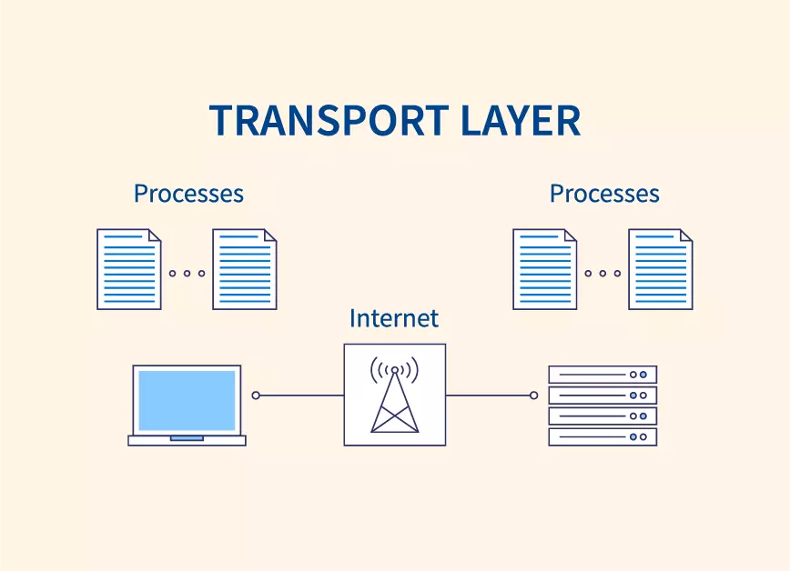
Transport Layer
Fourth layer in the OSI model, sits above the network layer.
Provides end-to-end communication between applications on different hosts.
Responsible for segmentation, flow control, error handling, and reliable data transfer.

Slide 4
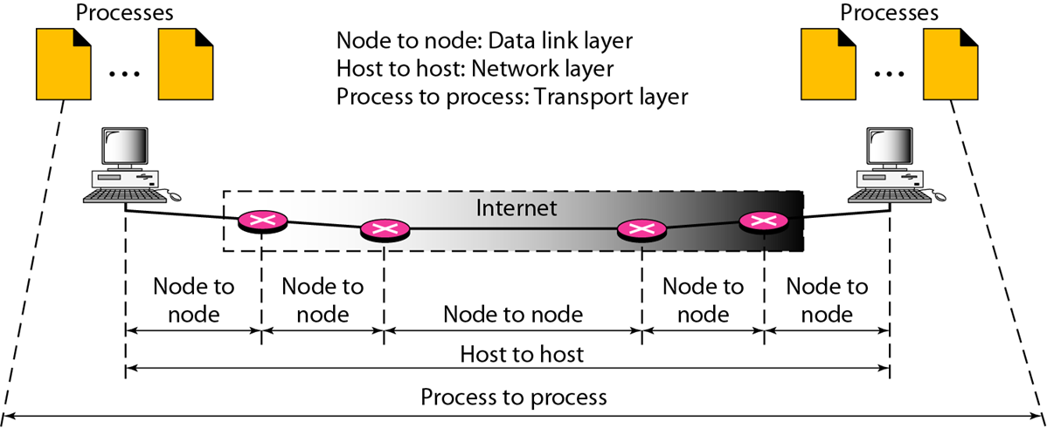
Transport Layer

Slide 5
Core Functionalities:
Segmentation and Reassembly: Divides messages into smaller segments at the sender and reassembles them at the receiver.
Connection Management: Establishes, maintains, and terminates logical connections (TCP).
Error Detection & Recovery: Ensures data integrity using checksums and retransmissions.
Flow Control: Prevents sender from overwhelming receiver (e.g., TCP's sliding window).
Congestion Control: Manages traffic load to avoid network congestion (TCP algorithms).
Multiplexing/Demultiplexing: Uses port numbers to allow multiple services over a single connection.

Slide 6
Common Protocols:
Protocol | Type | Characteristics | Use Case
TCP | Connection-oriented | Reliable, ordered, error-checked data | File transfer, web browsing
UDP | Connectionless | Fast, no guarantee of delivery/order | Video streaming, DNS, VoIP
SCTP | Connection-oriented | Multi-stream, multi-homing | Telecom signaling, web transport

Slide 7
TCP (Transport Layer Protocol):
TCP (Transmission Control Protocol) is a connection-oriented protocol that ensures reliable communication between devices over a network.
It establishes a connection using a three-way handshake and guarantees the ordered and error-free delivery of data.
TCP provides flow control, congestion control, and retransmission mechanisms for robust data transfer.
It is widely used in applications where reliability is crucial, such as Web browsing (HTTP/HTTPS), File transfer (FTP), and Email (SMTP).

Slide 8
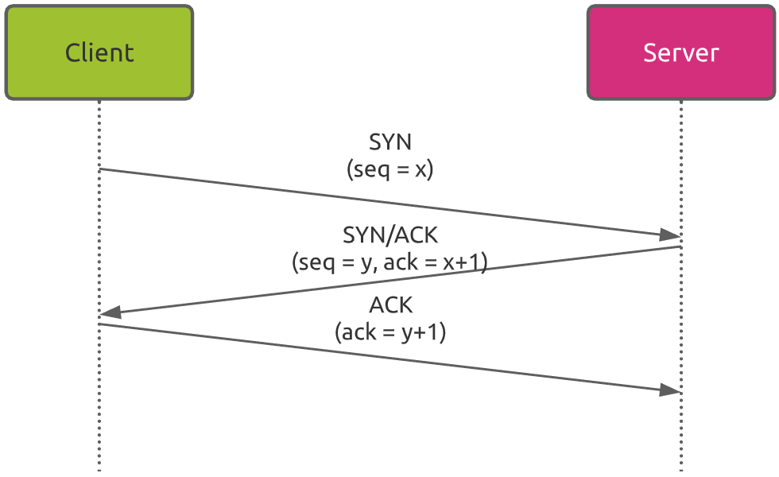
Three-Way Handshake Process in TCP :

Slide 9
Three-Way Handshake Process:
Step 1: SYN (Synchronize) – Client to Server
The client initiates the connection.
Sends a TCP segment with the SYN flag set.
Includes the client’s Initial Sequence Number (ISN).
Indicates the client wants to establish a connection and begin communication.
Step 2: SYN-ACK (Synchronize-Acknowledge) – Server to Client
The server receives the SYN request.
Sends back a segment with both SYN and ACK flags set.
Acknowledges the client’s ISN (ACK = x + 1).
Sends its own ISN (Seq = y).

Slide 10
Three-Way Handshake Process:
Step 3: ACK (Acknowledge) – Client to Server
The client receives SYN-ACK from the server.
Sends a final segment with the ACK flag set.
Acknowledges the server’s ISN (ACK = y + 1).
Connection is now established and ready for data transmission.
🔹 After the Handshake:
A bi-directional, full-duplex TCP connection is established.
Both parties can now reliably exchange data.

Slide 11
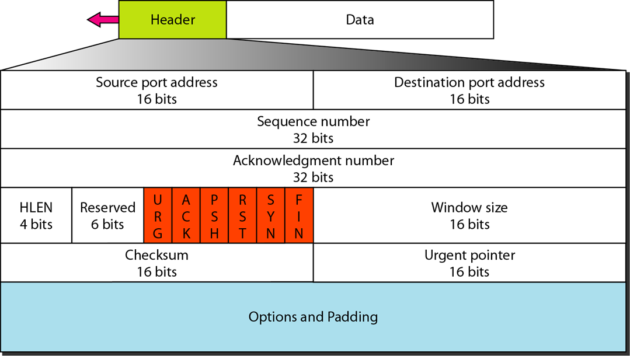
TCP Header:

Slide 12
TCP Header:
Field | Size (bits) | Description
Source Port | 16 | Port number of the sender (e.g., 54321)
Destination Port | 16 | Port number of the receiver (e.g., 80 for HTTP)
Sequence Number | 32 | Number of the first byte of data in this segment. Used for tracking data.
Acknowledgment Number | 32 | Next expected byte from the other side (used in ACK).
Data Offset (Header Length) | 4 | Length of the TCP header in 32-bit words (minimum 5 = 20 bytes).

Slide 13
TCP Header:
Field | Size (bits) | Description
Control Flags (9 bits) | 9 | Control bits (e.g., SYN, ACK, FIN):
Window Size | 16 | Amount of data (in bytes) the receiver can accept (used in flow control).
Checksum | 16 | For error-checking the header and data.
Urgent Pointer | 16 | Points to urgent data in the segment (only if URG is set).
Options (if any) | Variable | Used for things like window scaling, timestamps, etc.
Padding | Variable | Ensures the header is a multiple of 32 bits.

Slide 14
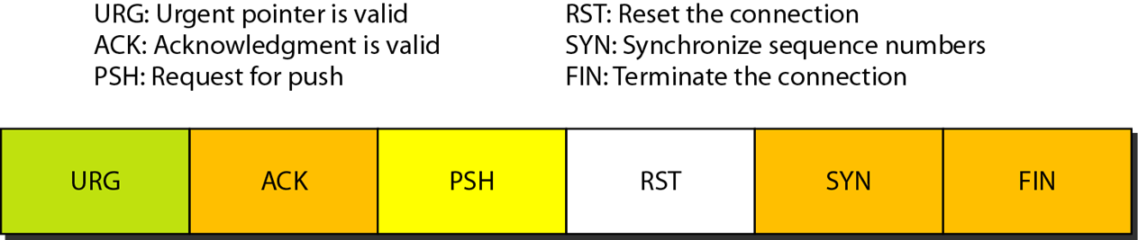
Control Fields in TCP Header:

Slide 15
TCP Congestion Control:
TCP Congestion Control is a set of mechanisms used to prevent network overload by controlling the rate of data transmission.
It dynamically adjusts the sender’s transmission rate based on network feedback, ensuring efficient and fair bandwidth usage.
Key algorithms include Slow Start, Congestion Avoidance, Fast Retransmit, and Fast Recovery.
Congestion control is essential for maintaining network stability, reducing packet loss, and optimizing throughput in TCP communications.

Slide 16
Phases in TCP Congestion Control:
Slow Start
Congestion Avoidance
Fast Retransmit & Fast Recovery

Slide 17
Why Congestion Occurs?
Too many packets in the network → buffer overflow → packet loss.
Caused by:
High traffic from multiple users.
Limited bandwidth or slow routers.
Sudden spikes in data transmission.

Slide 18
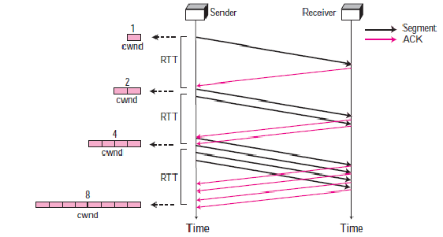
Slow Start Phase:

Slide 19
Slow Start Phase:
Begins with a small congestion window (cwnd) size (typically 1 MSS – Maximum Segment Size).
Each ACK received doubles the cwnd every round-trip time (RTT).
The growth is exponential:
cwnd = cwnd × 2 per RTT
This continues until one of the following occurs:
A packet is lost (congestion detected)
cwnd reaches a threshold value known as ssthresh (Slow Start Threshold)
If cwnd reaches ssthresh ( Slow Start Threshold ), TCP exits Slow Start and enters the Congestion Avoidance phase.

Slide 20
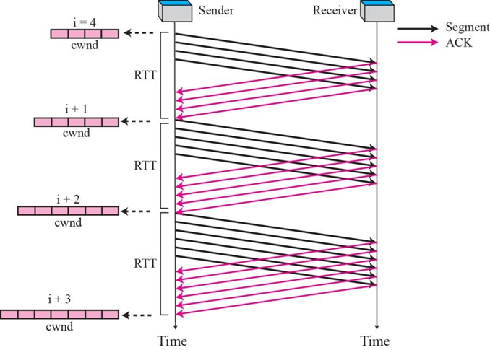
Congestion Avoidance Phase:

Slide 21
Congestion Avoidance Phase:
Congestion window (cwnd) grows linearly, not exponentially.
Designed to avoid sudden congestion and maximize stable throughput.
For each ACK received, increase cwnd slightly: cwnd = cwnd + (1 / cwnd)
For each RTT:
cwnd = cwnd + 1
If packet loss is detected again:
ssthresh is updated to cwnd / 2.
cwnd is reduced, and TCP may re-enter Slow Start or Fast Recovery.

Slide 22
Fast Retransmit & Fast Recovery (3rd Phase):
Fast Retransmit | Fast Recovery
Fast Retransmit is a mechanism that detects packet loss early, without waiting for a retransmission timeout (RTO). It is triggered when the sender receives 3 duplicate ACKs for the same data segment. | After Fast Retransmit, TCP enters the Fast Recovery phase instead of falling back to Slow Start. This phase allows the sender to recover quickly from minor packet losses without reducing throughput drastically.

Slide 23
How it Works:
Sender receives 3 duplicate ACKs.
Enters Fast Retransmit:
Retransmits the missing segment immediately.
Enters Fast Recovery:
Reduces congestion window (cwnd = ssthresh)
Inflates cwnd temporarily to maintain flow.
Upon receiving new ACK:
Exits Fast Recovery.
Returns to Congestion Avoidance.

Slide 24
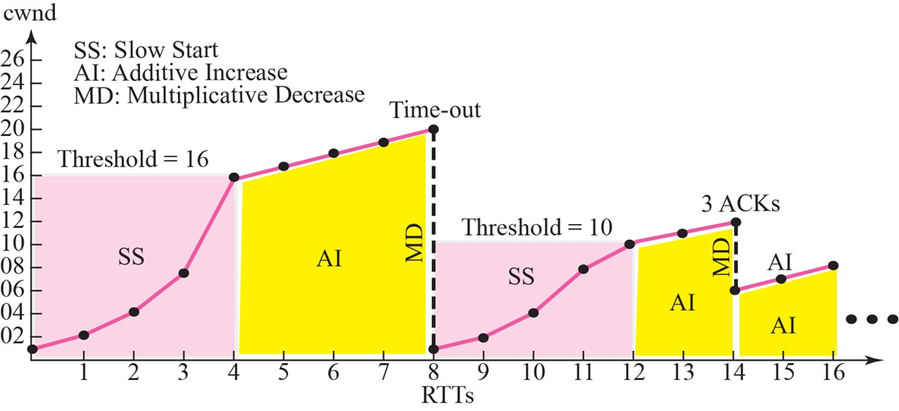
Congestion Example:

Slide 25
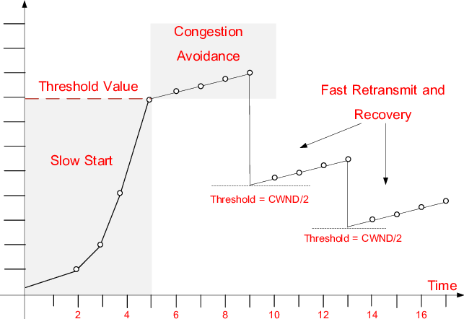
Summary:

Slide 26
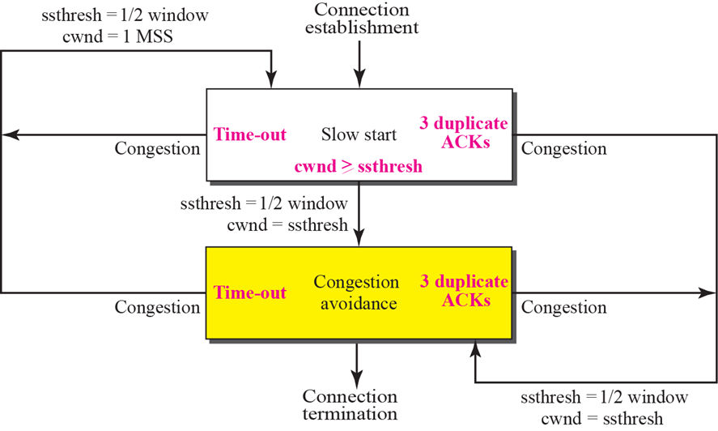
TCP Congestion Policy Summary:

Slide 27
UDP (User Datagram Protocol):
UDP (User Datagram Protocol) is a connectionless transport layer protocol that allows fast transmission of data without establishing a prior connection.
It provides minimal overhead by not guaranteeing delivery, order, or error correction — making it lightweight and efficient.
UDP is ideal for applications that prioritize speed over reliability, such as real-time audio/video streaming and online gaming.
Common protocols that use UDP include DNS, DHCP, VoIP, and live broadcasts, where some data loss is acceptable.

Slide 28
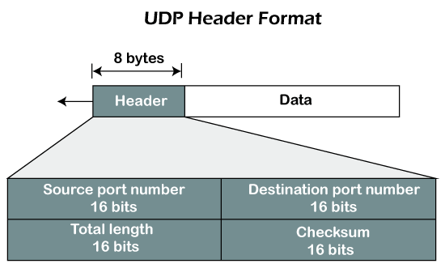
UDP Header:

Slide 29
UDP Header:
1. Source Port (16 bits):
Indicates the port number of the sending application.
Helps the receiver identify which application sent the data.
Can be zero if the sender does not need a reply.
2. Destination Port (16 bits):
Indicates the port number of the receiving application.
The most important field for directing the datagram to the right process.
Common UDP destination ports:
DNS → 53, HTTP→ 80, HTTPS→ 443.

Slide 30
UDP Header:
3. Length (16 bits):
Specifies the total length of the UDP datagram (header + data) in bytes.
Minimum value = 8 bytes (if no data).
Total Length = UDP Header (8 bytes) + Data length
4. Checksum (16 bits):
Provides error detection for the header and data.
Mandatory in IPv6; optional in IPv4 (but usually used).
It Covers:
UDP header
UDP data
A pseudo-header from the IP layer, including: Source IP address, Destination IP address, Protocol ,UDP Length.

Slide 31
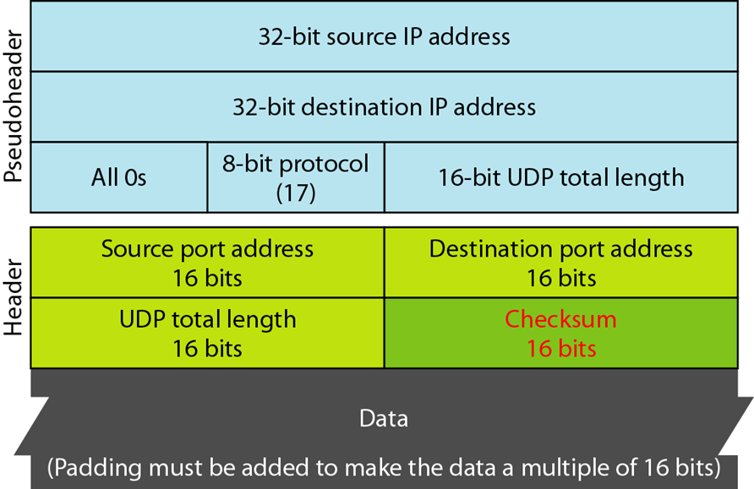
Pseudo Header for Checksum Calculation:

Slide 32
TCP Vs UDP:
Basis of Comparison | TCP (Transmission Control Protocol) | UDP (User Datagram Protocol)
Connection | Connection-oriented (requires handshake) | Connectionless (no handshake)
Reliability | Reliable – ensures delivery and retransmission | Unreliable – no guarantee of delivery
Ordering | Preserves packet order | No ordering – packets may arrive out of order
Flow Control | Supported using sliding window | Not supported
Congestion Control | Supported using algorithms (slow start, etc.) | Not supported
Speed | Slower due to overhead | Faster due to minimal overhead
Header Size | 20–60 bytes | 8 bytes
Overhead | High – due to connection management | Low – simple structure
Suitability | Reliable applications (e.g., HTTP, FTP, SMTP) | Real-time apps (e.g., VoIP, DNS, streaming)

Slide 33
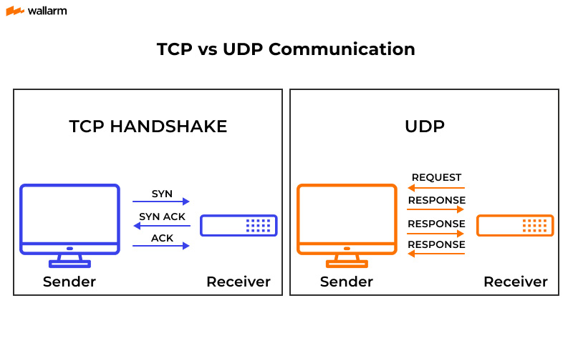
TCP Vs UDP:

Slide 34
SCTP (Stream Control Transmission Protocol):
SCTP (Stream Control Transmission Protocol) is a reliable, message-oriented, transport layer protocol.
It combines features of TCP (reliability) and UDP (message-based) with advanced functionalities like multi-streaming and multi-homing.
Defined by IETF in RFC 4960, SCTP is suitable for applications that require robust and redundant communication.
It ensures ordered and unordered delivery options across multiple independent streams within a single connection, preventing head-of-line blocking.

Slide 35
Key Features of SCTP:
Feature | Description
Message-Oriented | Preserves message boundaries (unlike TCP, which is stream-oriented).
Reliable Delivery | Provides error detection, retransmission, and acknowledgment mechanisms.
Ordered and Unordered Delivery | Supports both, on a per-stream basis.
Multi-Streaming | Allows multiple logical streams within one SCTP connection to avoid Head-of-Line blocking.
Multi-Homing | Supports multiple IP addresses per endpoint for path redundancy and fault tolerance.
4-Way Handshake | Used for connection establishment to prevent SYN flooding attacks.

Slide 36
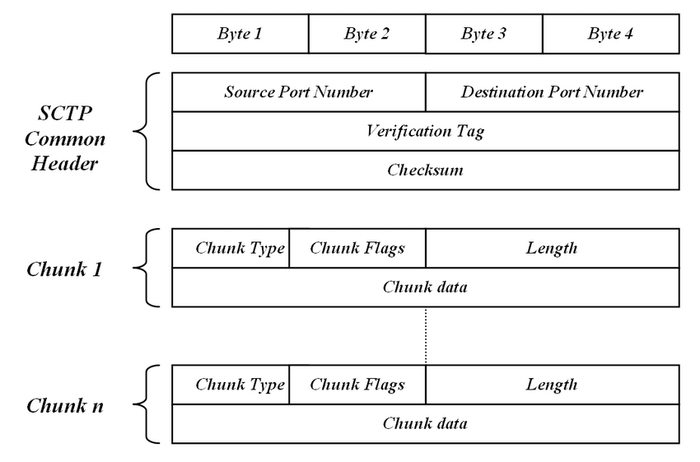
SCTP Packet Format:

Slide 37
SCTP Packet Format:
Common Header (12 bytes):
Source Port (16 bits)
Destination Port (16 bits)
Verification Tag (32 bits)
Checksum (32 bits)
Chunks (variable length):
Control Chunks (INIT, SACK, HEARTBEAT)
Data Chunks (user messages)

Slide 38
Connection Establishment in SCTP( 4-Way Handshake):
INIT → client sends request to initiate association.
INIT-ACK → server responds with its own parameters.
COOKIE-ECHO → client echoes back server’s state cookie.
COOKIE-ACK → server confirms, and the connection (association) is established.
Advantage: Prevents SYN flooding attacks that TCP is vulnerable to.

Slide 39
SCTP Vs TCP Vs UDP:
Aspect | TCP | UDP | SCTP
Reliability | Yes | No | Yes
Connection-Oriented | Yes | No | Yes (Association-based)
Message-Oriented | No (Byte stream) | Yes | Yes
Multi-Streaming | No | No | Yes
Multi-Homing | No | No | Yes
Congestion Control | Yes | No | Yes
Ordered Delivery | Yes | No | Optional per stream

Slide 40
Port Address:
A port address (also called a port number) is a logical address used by the Transport Layer to identify specific processes or services on a host.
While the IP address identifies the device (host) on the network, the port number identifies the specific application or service running on that device.
A port number is a 16-bit unsigned integer.
Enables multiplexing and demultiplexing:
Multiplexing: Multiple applications use the network simultaneously.
Demultiplexing: Incoming data is delivered to the correct app
Range: 0 – 2^16 -1
ie, 0 - 65,535.

Slide 41
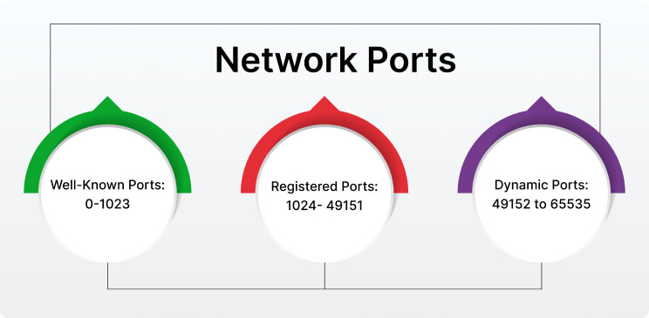
Classification of Port Address:

Slide 42
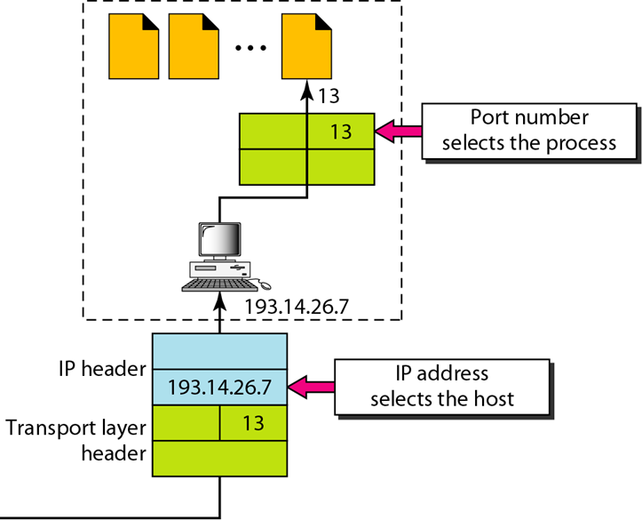
IP Address Vs Port Address:

Slide 43
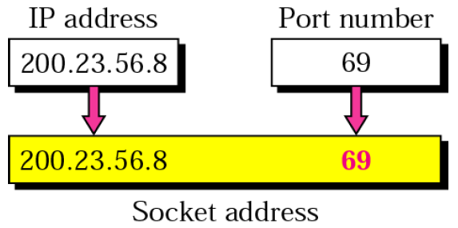
Socket Address:
A Socket Address is a unique identifier used to establish communication between two processes (applications) across a network.
It is a combination of two components:
Socket Address = IP Address + Port Number

Slide 44
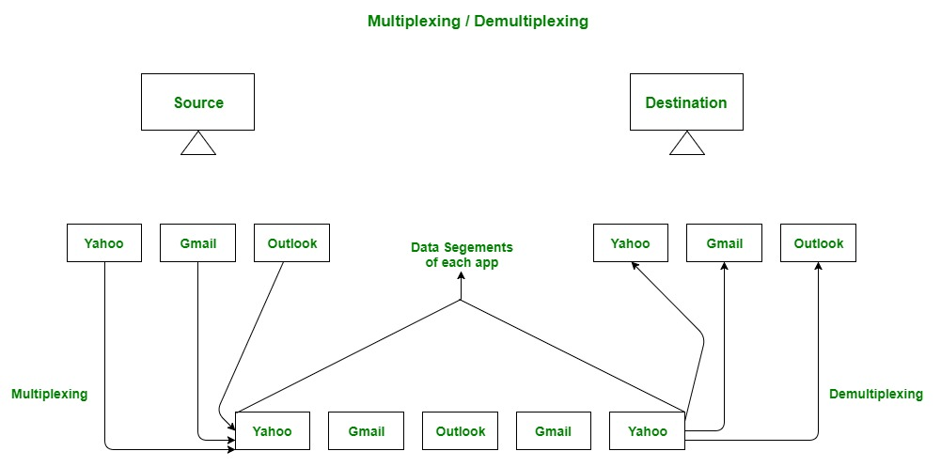
Multiplexing & Demultiplexing:

Slide 45
Multiplexing:
Multiplexing is a technique that allows multiple signals or data streams to be combined and transmitted over a single shared communication medium (e.g., wire, fiber, or channel).
It enables simultaneous communication by allowing multiple users or applications to efficiently share the same physical link without interference.
Multiplexing addresses the limitation of physical communication channels by maximizing bandwidth utilization and reducing infrastructure costs.
This technique ensures that different data streams do not collide, using methods like Time Division (TDM), Frequency Division (FDM), and Code Division (CDM).
It is applied at both the physical layer (e.g., signal multiplexing) and transport layer (e.g., port-based multiplexing in TCP/UDP) to support scalable and efficient networking.

Slide 46
Demultiplexing:
Demultiplexing is the process of delivering incoming data to the correct application or process based on identifiers like port numbers.
It is the reverse of multiplexing — while multiplexing combines data streams for transmission, demultiplexing separates and directs them at the receiver’s end.
At the Transport Layer, demultiplexing uses information such as destination IP address and port number to forward segments to the appropriate socket.
It enables multiple applications to receive data correctly and simultaneously, even when using the same network interface.
For example, a host receiving data on port 80 (HTTP) will deliver it to the web browser, while data on port 21 (FTP) goes to the file transfer client.

Slide 47
THANK YOU

